Slide 1

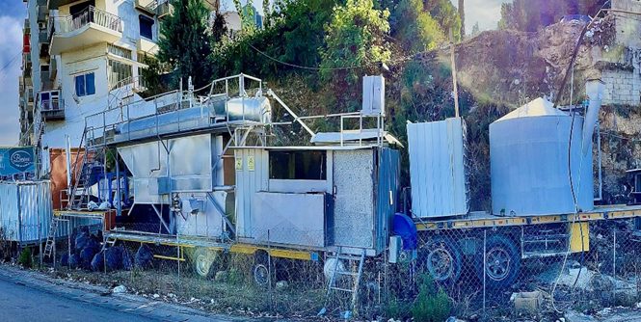
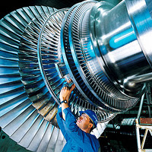
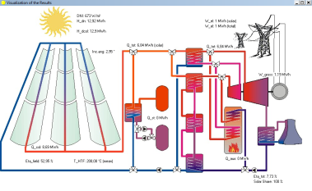
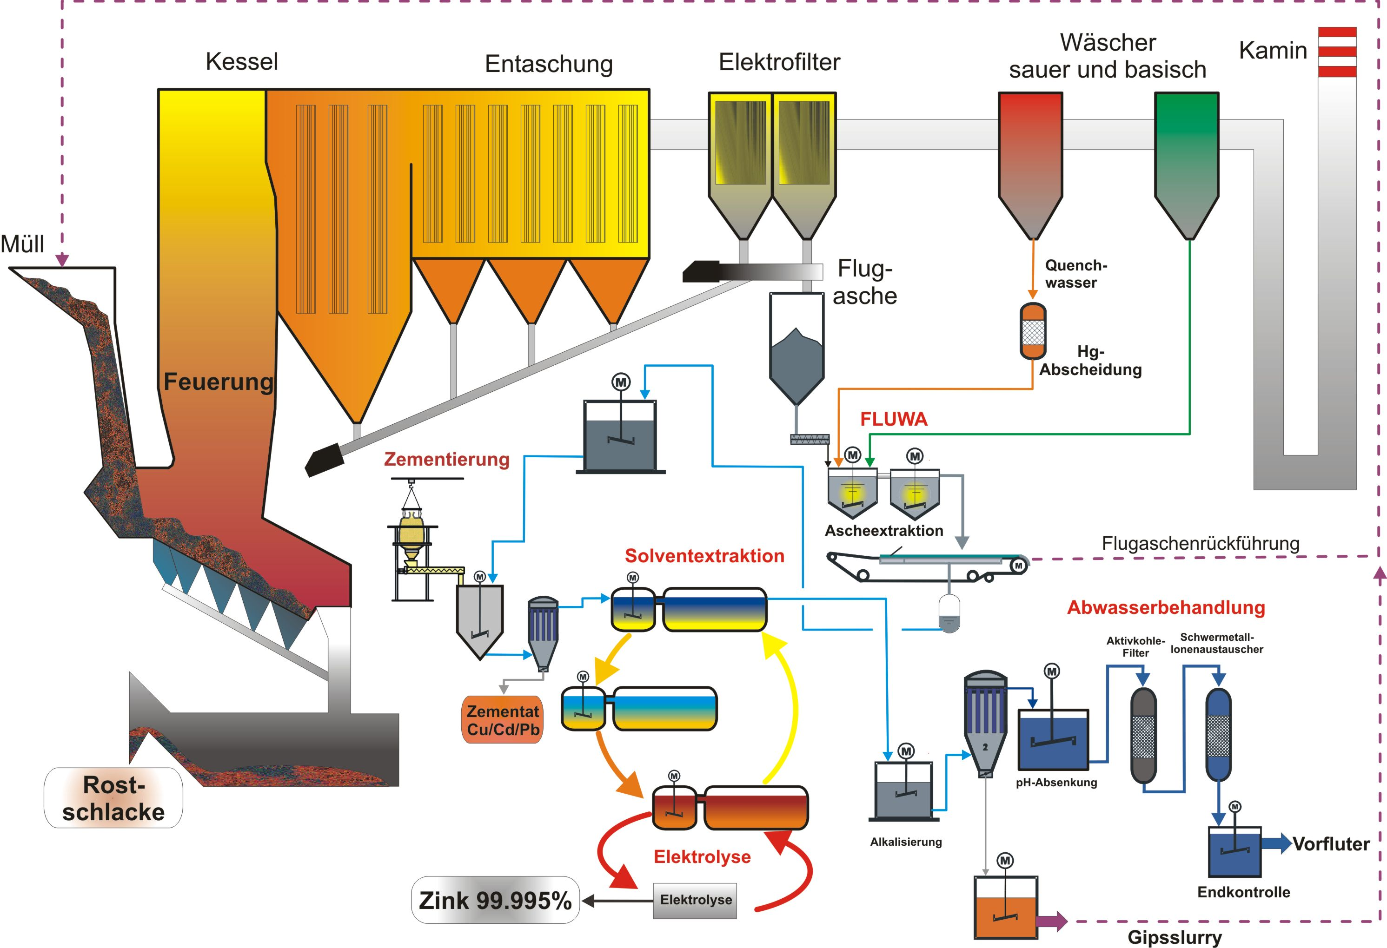
TEMO Power Plant Consulting
______________________________________________________
Preliminary Studies, Project Management and Process Control Systems
for Alternative and Conventional Power Plants
TEMO Soft-, Hardware & Consulting e.K.
Oberfeldstr. 1
76149 Karlsruhe, Germany
Dr. Eng. Samir Mourad
(Lebanon) ++961 76 341 526
(Germany) ++49 (0)1787285578
Email: info@temo-group.com
Website: www.temo-group.com
Eng. Ziyad Malek
(Lebanon) ++961 71 456 434
Eng. Mahmoud Zohby
(Lebanon) ++961 3 671 621

Slide 2

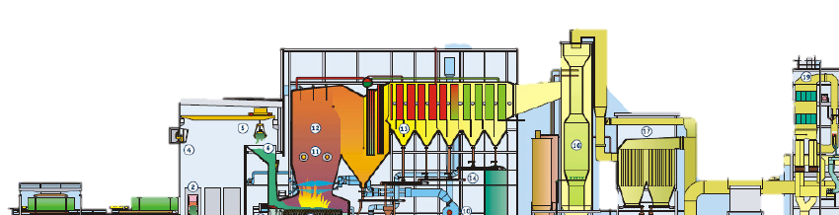
TEMO Power Plant Consulting
Introduction
TEMO power plant consulting is an part of the head TEMO consulting company in Germany, this section is specialize in power plant system, studying, design and build.
Since 2000, TEMO participate in many Process Control Systems for Alternative and Conventional Power Plants all around the world: Germany, Libya, Lebanon, Saudi Arabia…

Slide 3
Our Services
In the power plant and control system field

Slide 4

Our Services
Project & Supplier Management for Power Plant Installing
Preliminary Assessment Studies (with Tools as Greenius)
Consulting study for power plant and waste management
Design, Development and Installation of Power Plant
Incineration design and fabrication
Filtration system development: chemical and electro-filter
Process Control System (with Siemens S7 technology and others)
System and requirement engineer
Safety engineer

Slide 5
Our Projects
Some of our reference projects

Slide 6
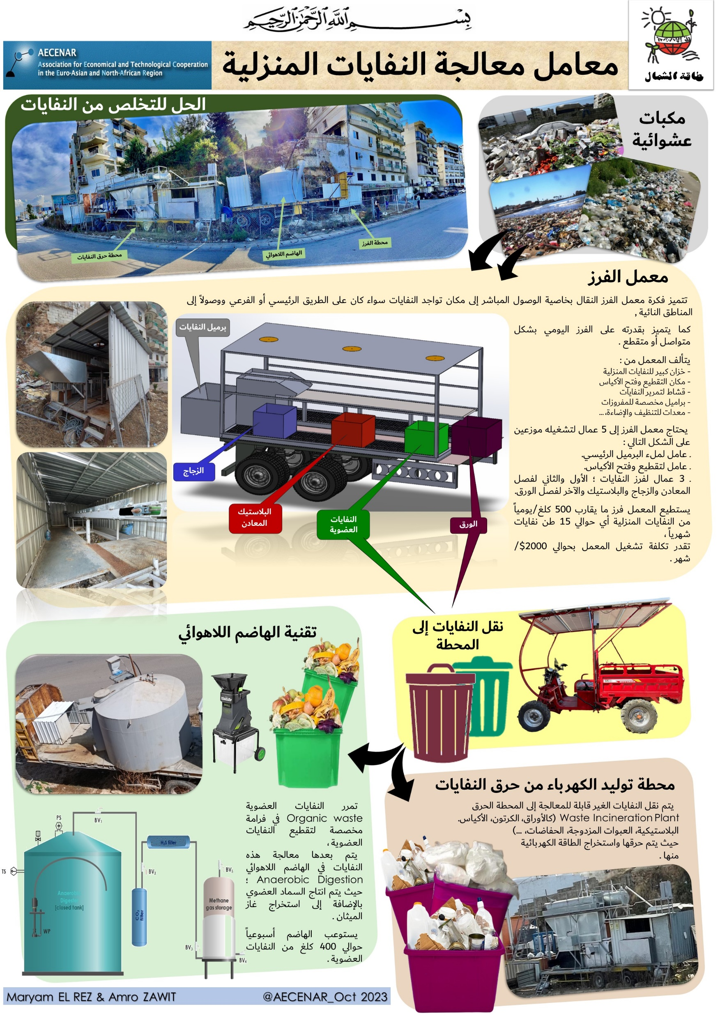
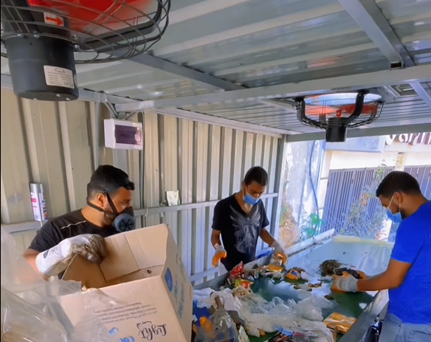
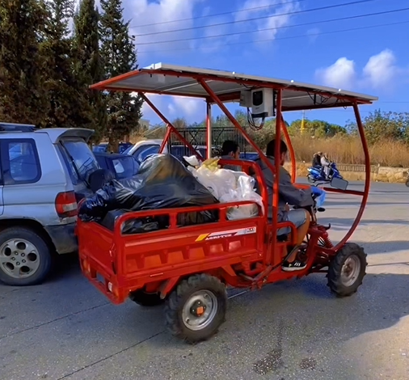
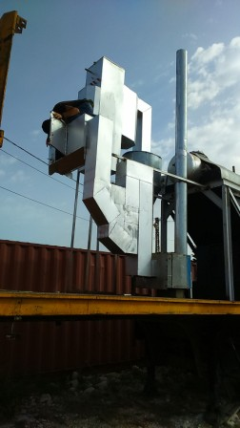
Operation of Mobile plant for landfills treatment
Lebanon, 2024
At a time when the region was struggling with the proliferation of random dumps, TEMO stepped in to operate the mobile waste treatment plant owned by NLAP and manage the entire process.
This included:
Waste transportation,
Sorting,
Incineration of designated waste in an environmentally
friendly way using three types of filtration,
Treatment of organic waste,
and the sale of recyclable materials
Use generated power to lighting the area
Utilization of methane gas produced by biogas

Slide 7
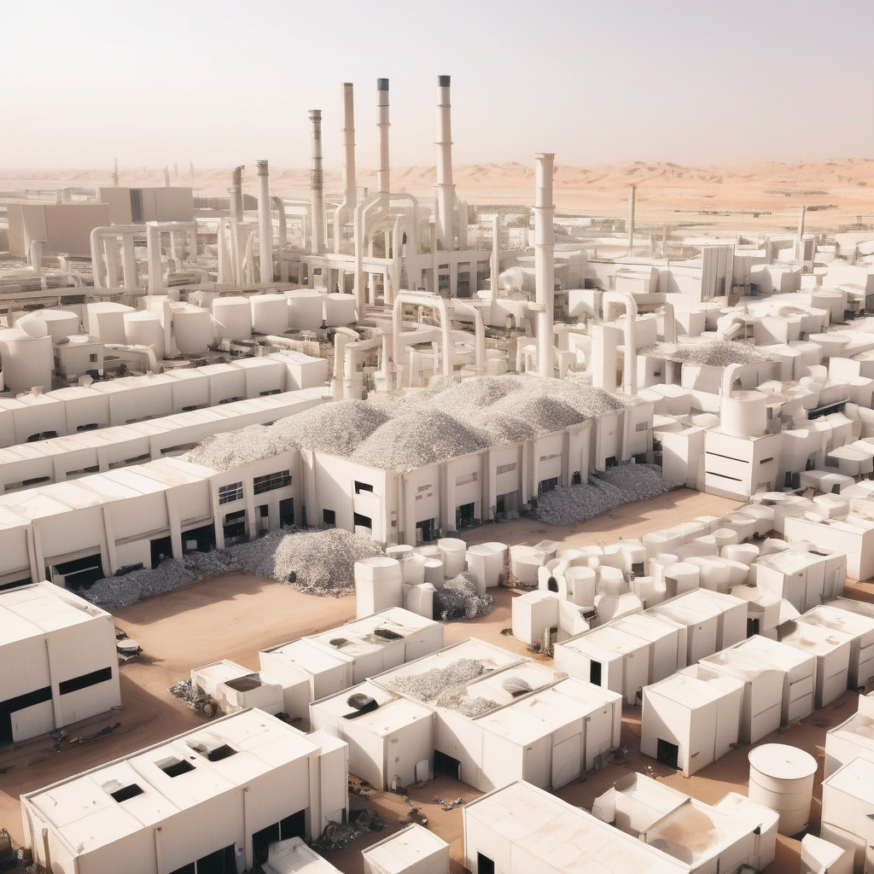
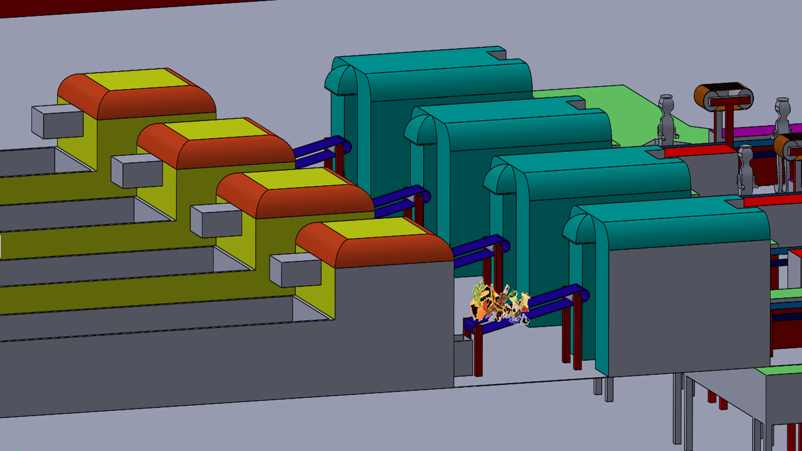
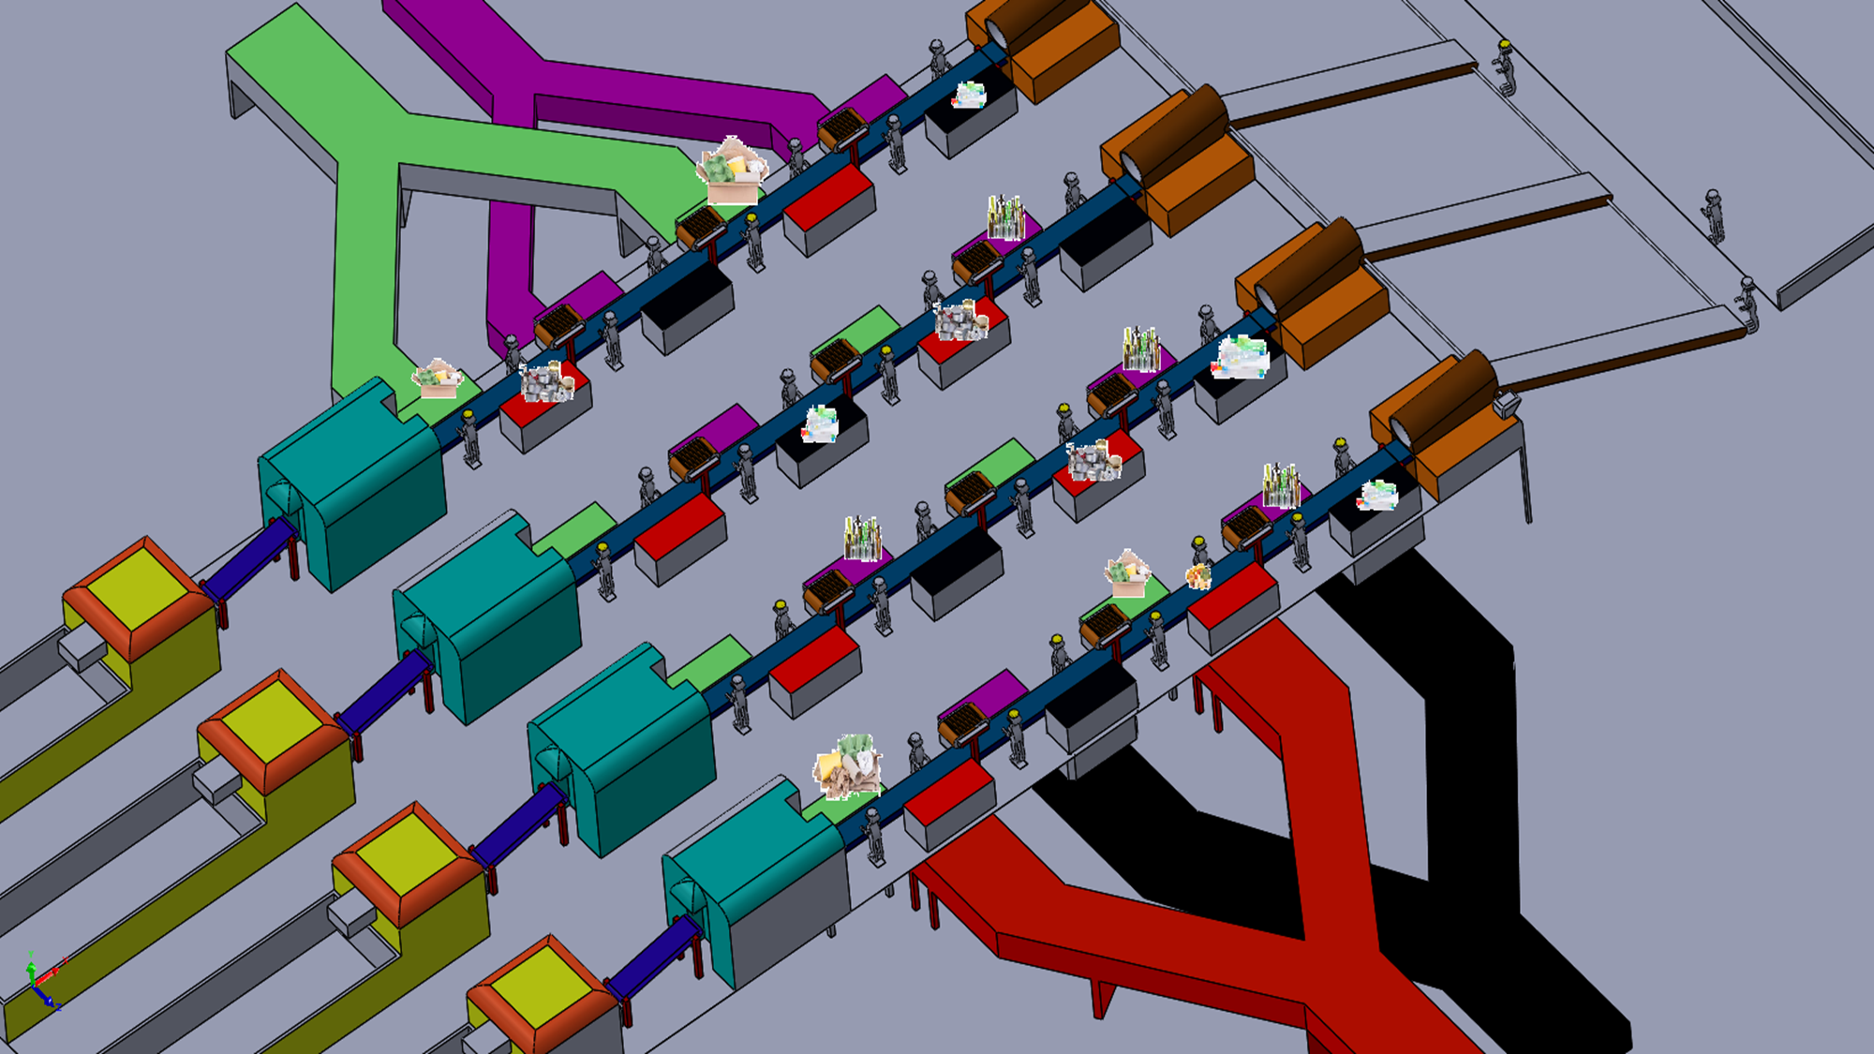
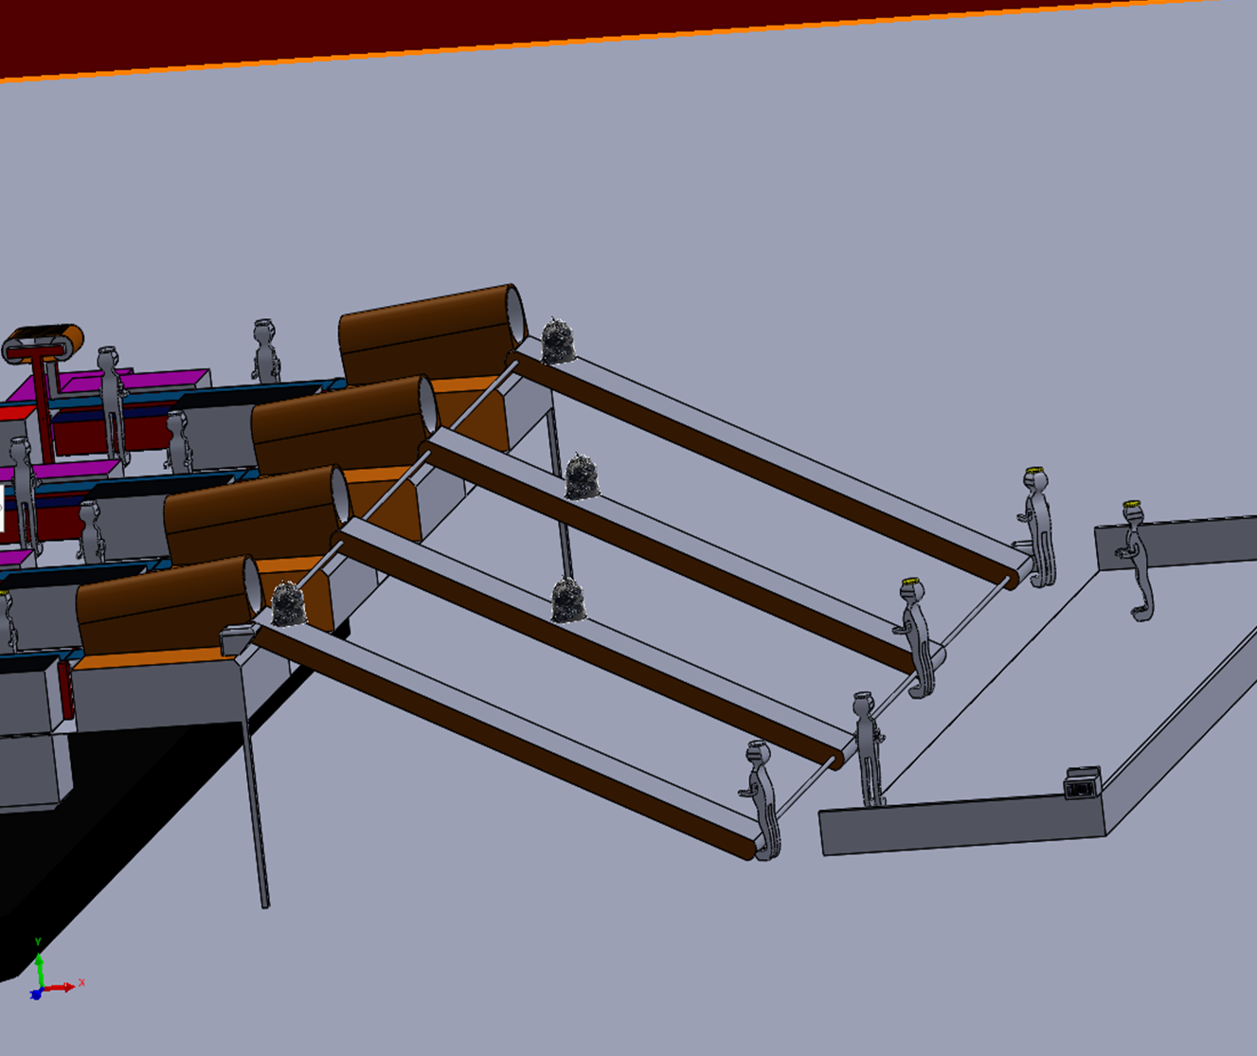
Sustainable Waste Management
Riyad KSA, 2023
The Project objective is to treat 1000 tons of household waste per day, recycle it, produce biogas and the rest gets into Burning Process
Our Proposed Solution
We have conducted comprehensive studies for a waste management plant capable of processing 1000 tons of waste per day.
Based on our findings, the complete waste management cycle for 1000 tons requires a land area of 50,000 square meters.
This facility will efficiently handle the waste treatment process, ensuring sustainable and effective waste management solutions.

Slide 8
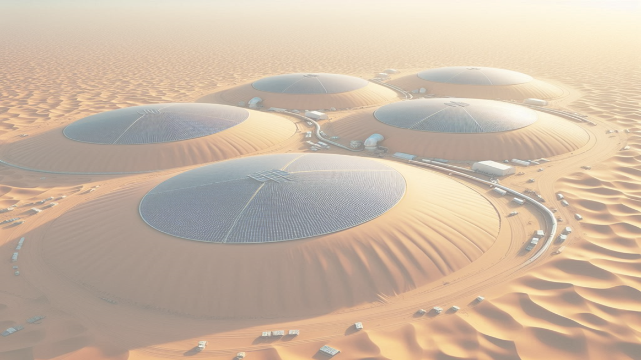
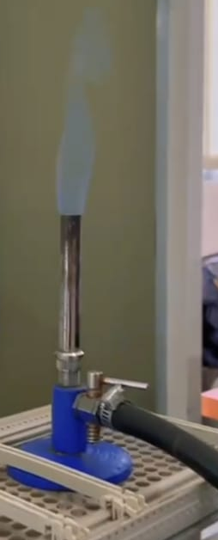
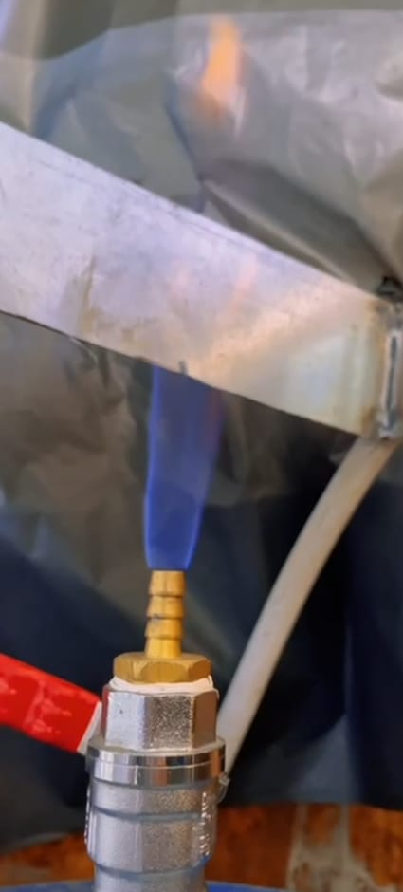
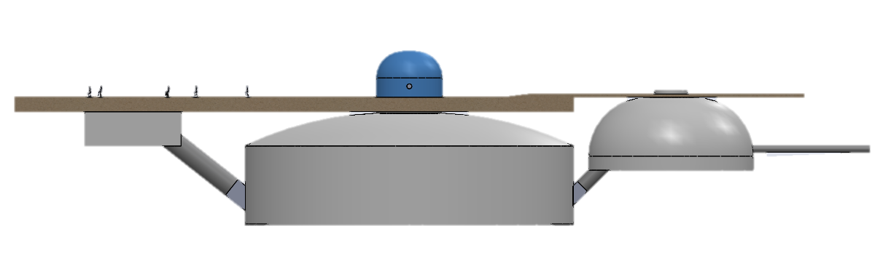
Biogas plant
Lebanon, 2022-2024
Mobile Biogas Power Plant
Project study & plan then management the development phase
Construction of the fermenter and associated instruments
Supervision of the production of the fermenter
Construction of an innovative gas turbine for biogas (methane) with regenerative cooling
Test specification/runs/analyzing
Root Cause Analysis for Failed Plant Starts

Slide 9
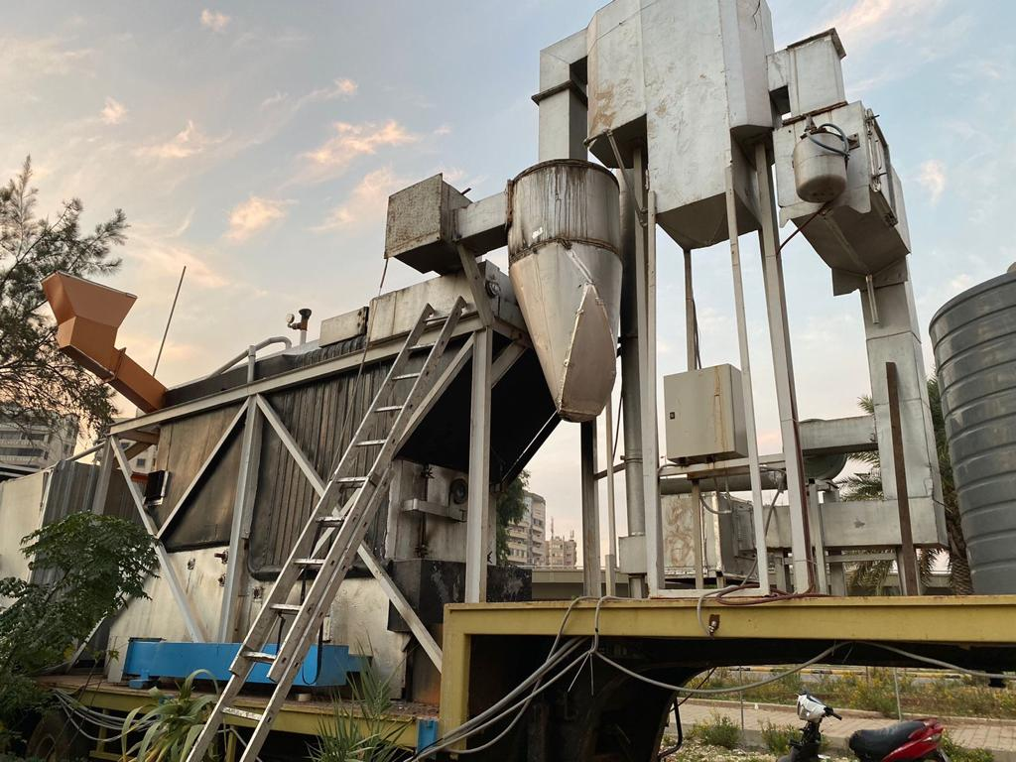
Mobile Waste to Electricity plant
NLAP Lebanon, 2015-2021
Environment Impact Assessment (EIA)
Testing, Test Specification
Mixing Test Rig for Innovative Guest turbine system
Control of Power Supply for Electrofilter (Power Electronics)
AC/DC converter
Test coordination for the process control system (boiler pressure control, turbine governing system, incineration control, flue gas cleaning system
Preparation of the specification and execution of the calculation according to customer requirements of a waste incineration system
Requirements according to DIN standards for boilers (including EN 12952-3) and for functional safety of electrical/electronic systems (EN 61511)
FEM Stress, Analysis
CFD study (pressure/temperature at the fresh steam outlet)
Tools/Standards : Power Electronics , Delta PLC, python, valves, pressure sensor, Flow sensors, C++, SIL Level 4, EN 61508

Slide 10
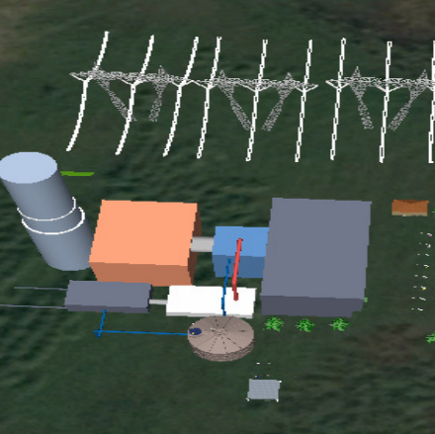
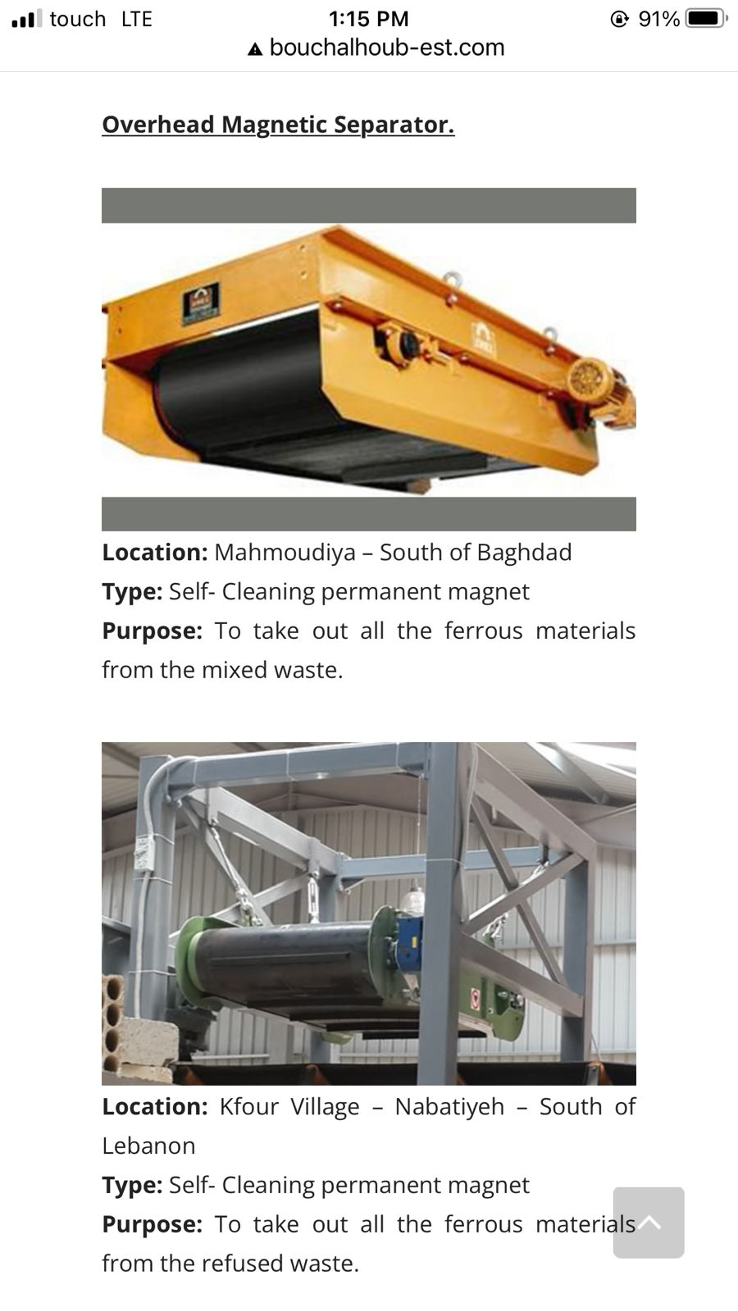
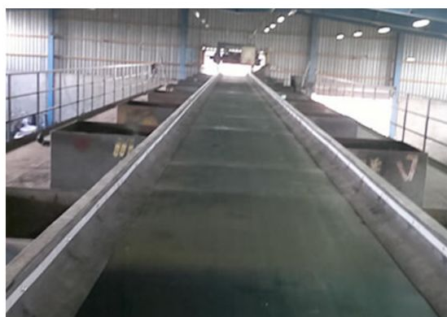
4MW waste to energy plant
Batroun LB, 2013/2014
Full study and design for a 4 MW power plant by waste burn, starting from the waste sorting to the ashes burn and bio treatment for the organic waste.

Slide 11
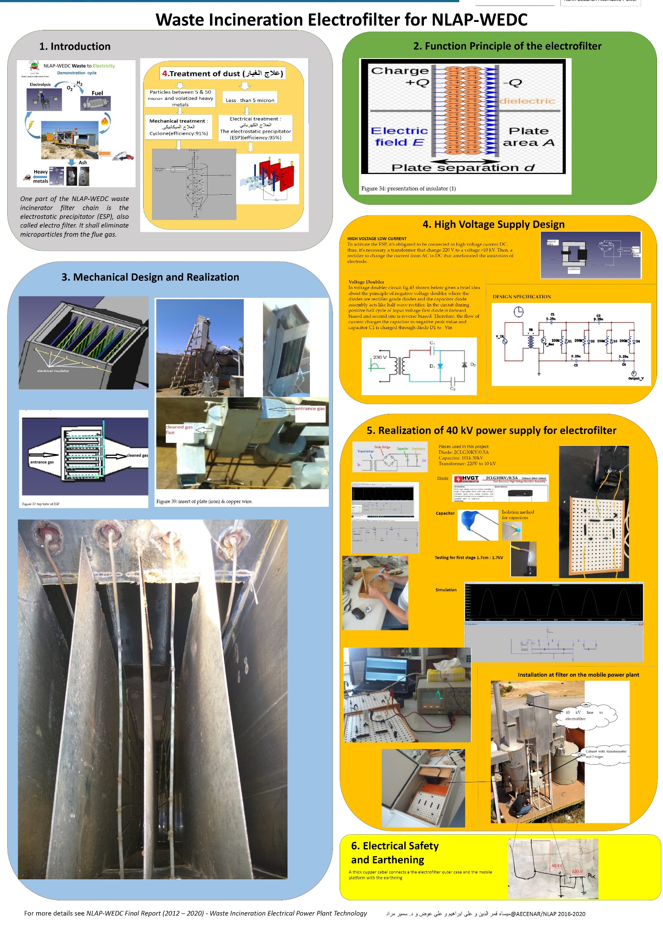
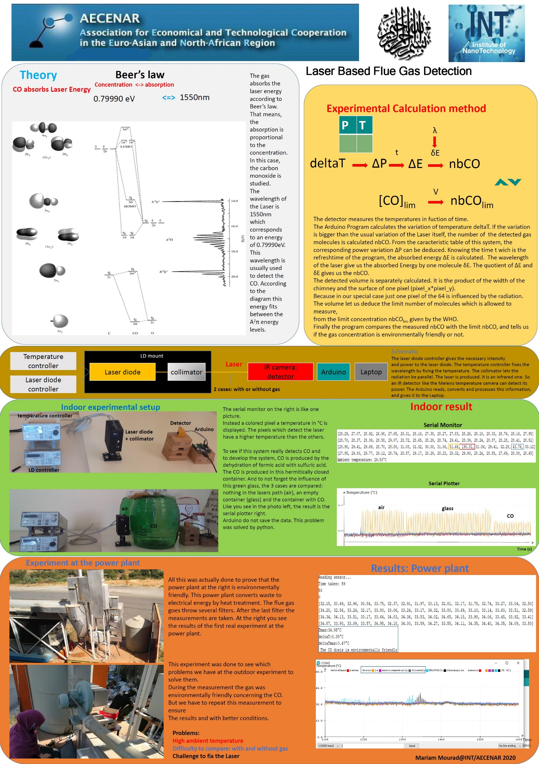
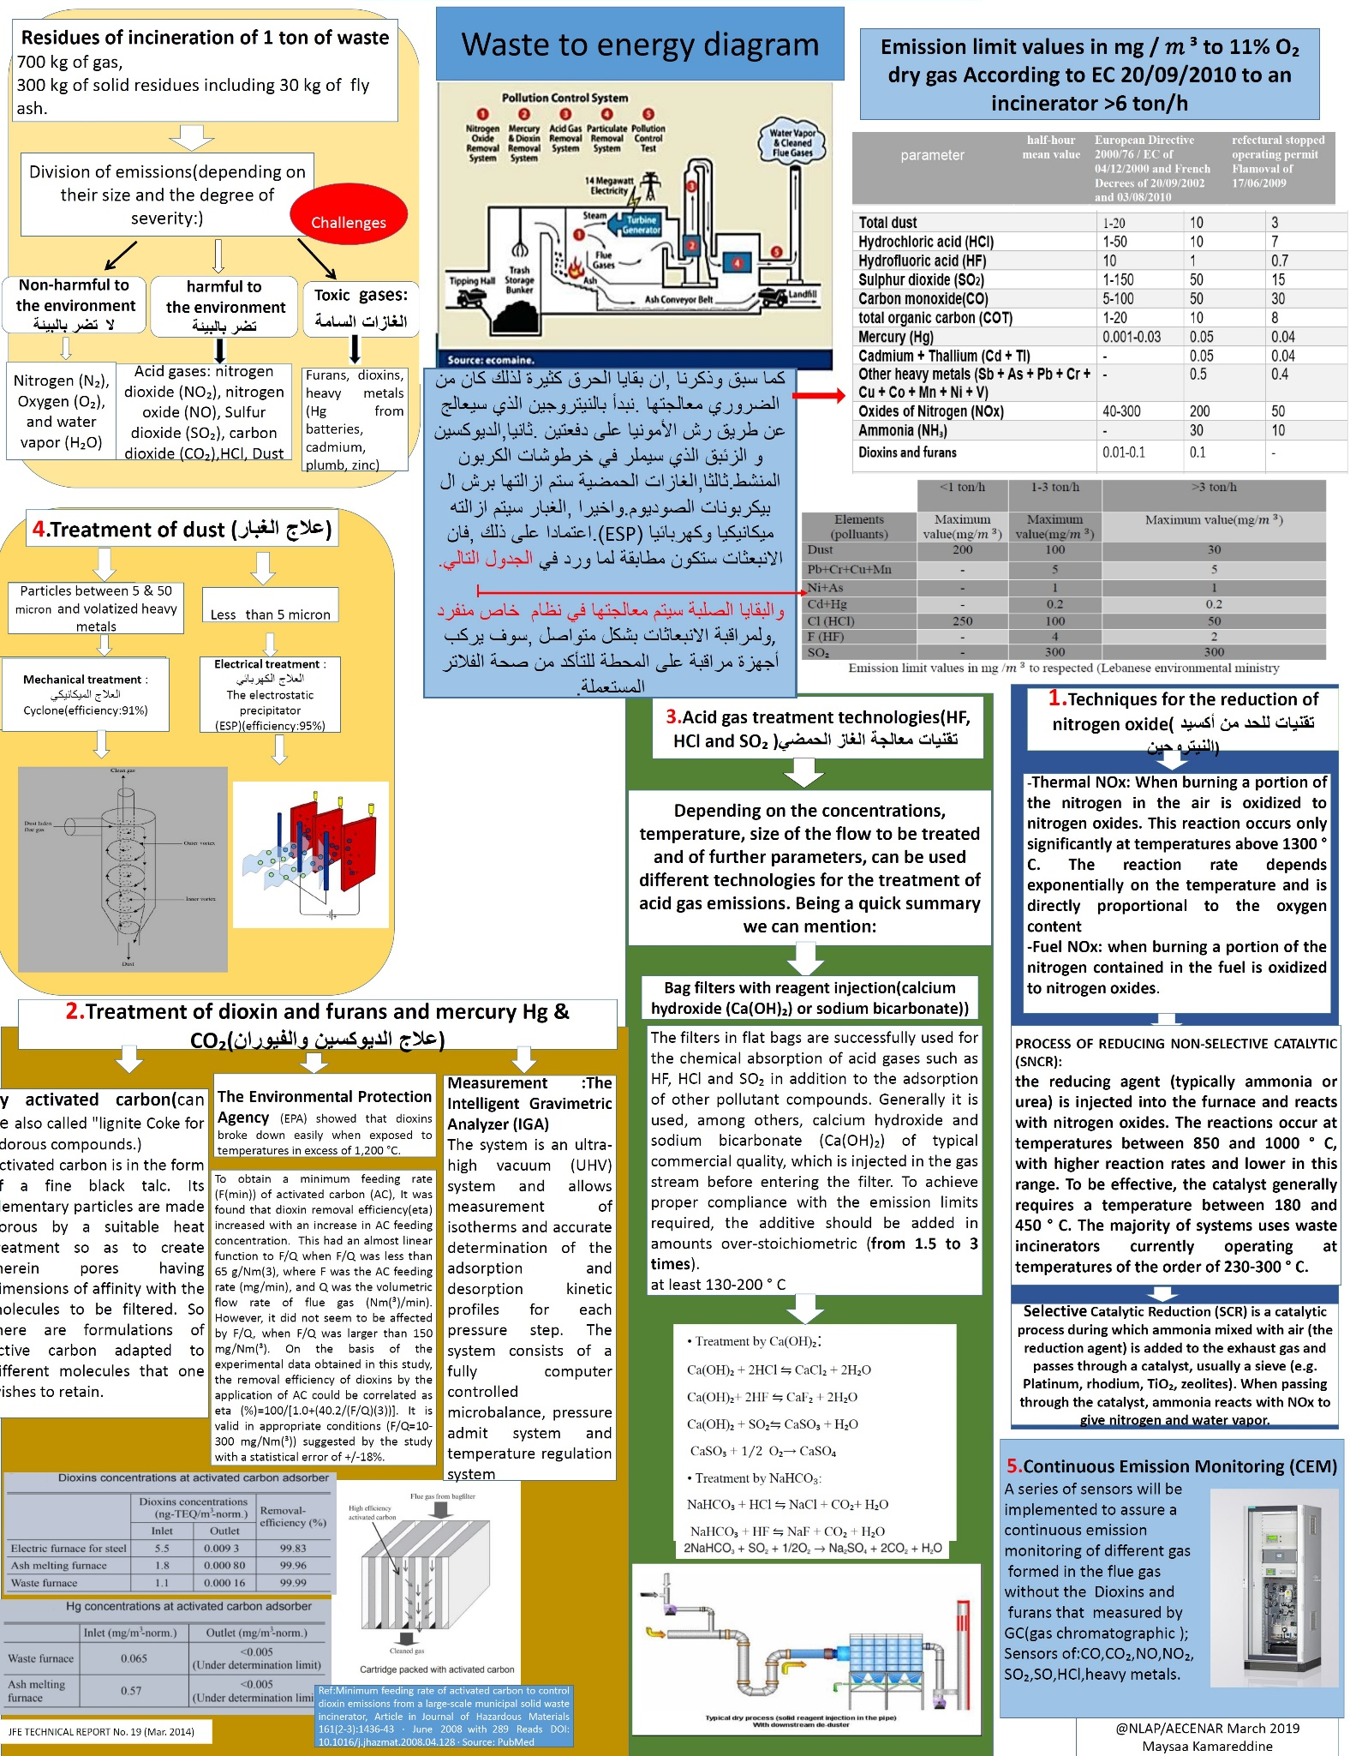
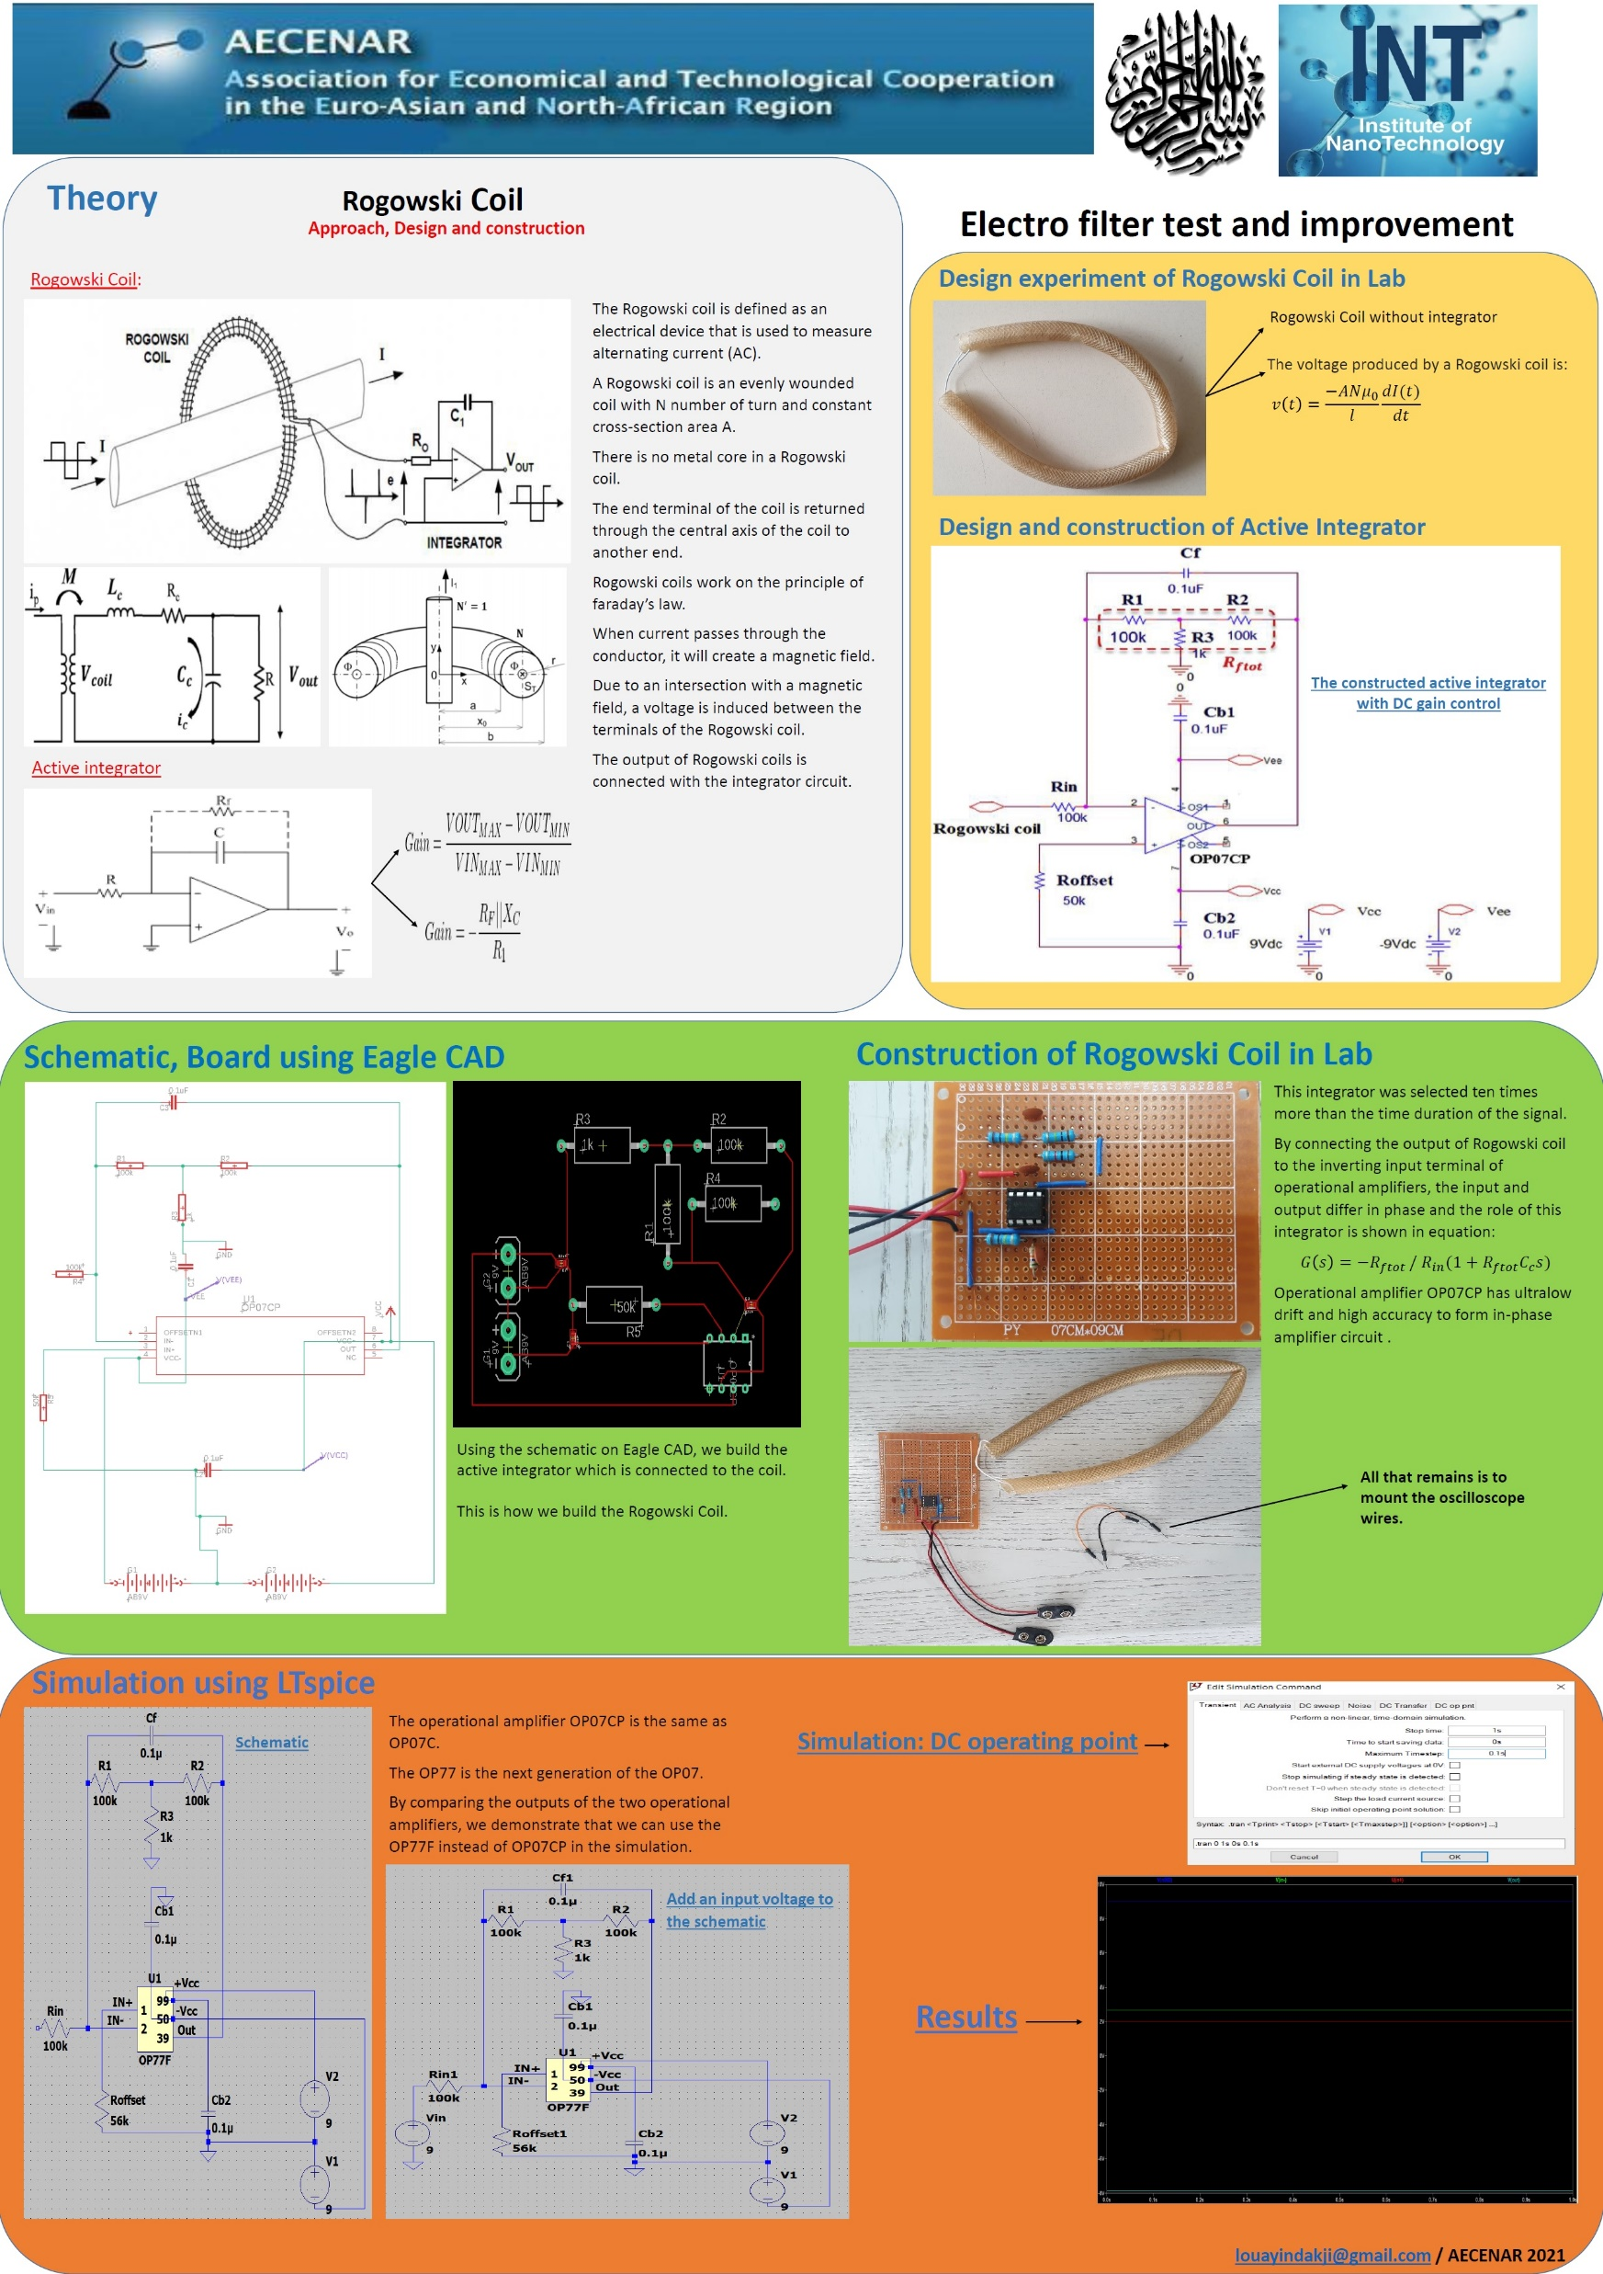
filter system development
(Electro-filter)
Lebanon, 2012

Slide 12
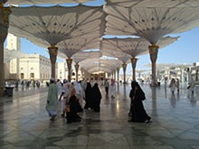
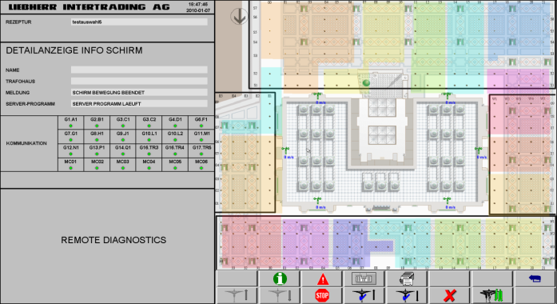
Umbrellas of the prophet‘s mosque
Madina KSA, 2009/2010
TEMO Consulting was a subcontractor of Liebherr,
the main contractor of Saudi Bin Laden Group
TEMO was responsible for the umbrella control system visualization and documentation and for parts of the watermisting control system

Slide 13
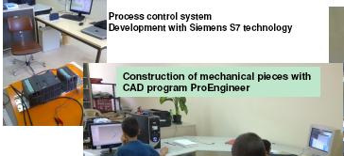
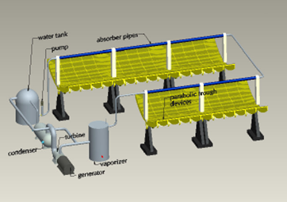
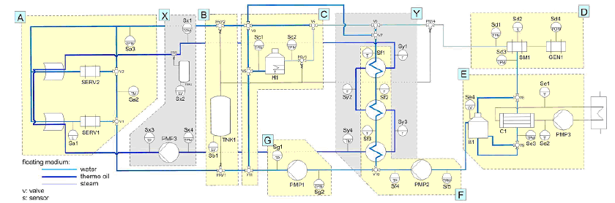
solar thermal power plant test rig
Germany, 2006-2011
TEMO Consulting lead the whole project, which was a cooperation project with different applied research institutes from Germany

Slide 14



Oldest projects/participation
2000-2006
03/2006 | ProMinent GmbH / Mechanical Engineering
 | Test engineer
 | Reengineering and test strategy development for an embedded system for dosing pumps Tools: V-model, C
10/2000 - 02/2006 | VaEf / Aviation
 | Development Engineer / Project Management
 | Project management development of a control system for a mobile real-time system Integration of the components (sensors, actuator control, communication, user interface) of a flight control system for an alternative airship Tools: Rapid Prototyping, VxWorks, V-Modell, C, embedded systems, CargoLifting , C++, MFC
08/2005 | Behr-Hella GmbH / Automotive
 | Test engineer
 | Creation of the requirements database (Doors) for a DC motor control within the tests for an air conditioning control system Tools: DOORS, MID Innovator
11/2004 - 04/2005 | Johnson Controls Inc. / Automotive
 | Requirements engineer
 | Software coordination for a new combination device SMART interface between the SW department of Johnson Controls and the customer Requirements engineering Preparation of audits for Quality Assurance with SPICE Level 2 Tools: RequisitePro , TestTrackPro , CAN, CANOE, CAN forecast, C, C++

Slide 15
Oldest projects/participation
2000-2006
09/2002 - 11/2002 | Harman-Becker GmbH / Automotive
 | Test engineer / Project manager
 | Quality assurance system test Introduction of the V-model Preparation of production plans Documentation of software and hardware Project management Tools: V-Modell, C, C++, DSP, Embedded Systems
2001 | Alcatel AG / local rail transport
 | Development engineer
 | Development of safety-relevant software Specification, analysis, design and implementation of telegram reception modules for the Munich subway Tools: C, DOORS, Innovator, SA/SD, ATOL, Clear Case
2000 | Institute of Flight Mechanics Stuttgart / Aviation
 | Development engineer
 | Redesign and simulation of a control system for a real-time system Software Architecture, Software Design, Development, documentation Tools: Rapid prototyping, C, C++, V-model, UML, VxWorks, MatrixX, Visual Basic, conversion from HiL to SiL, cascaded flight control loop, SiL test specifications, SiL test execution

Slide 16
TEMO Power Plant Consulting
______________________________________________________
Preliminary Studies, Project Management and Process Control Systems
for Alternative and Conventional Power Plants
Addresses:
Contacts:
TEMO Soft-, Hardware & Consulting e.K.
Oberfeldstr. 1,76149 Karlsruhe, Germany
Dr. Eng. Samir Mourad
Samir.Mourad@temo-group.com
(Lebanon) ++961 76 341 526, (Germany) ++49 (0)1787285578
TEMO AS-COMSAT
Kafiye Sk. 47, 34771 Ümraniye/İstanbul, Türkei
Eng. Ziyad Malek
(Lebanon) ++961 71 456 434
TEMO NLAP
Harba building, Hiykal, Koura, North Lebanon
Eng. Mahmoud Zohby
Mahmoud.Zohby@temo-group.com
(Lebanon) ++961 3 671 621

